Slide 1
MapML – OGC API Integration
OGC Open Standards Code Sprint
Peter Rushforth
13 June 2024

Slide 2
Agenda
Why is implementing MapML in OGC API important?
The Structure Of MapML
The Viewer
Tiled Coordinate Reference Systems
Layers
How does MapML match up with OGC APIs for
Maps,
Tiles
Features
MapML Software Resources
For clients / Web browsers – Web-Map-Custom-Element
For Servers - GeoServer – WMS, WMTS, WFS, HTML preview

Slide 3
Why is implementing MapML in OGC API important?
To obtain implementation experience-based feedback from the geospatial standards community.
Such feedback is essential in “making the case” that maps, and in particular, MapML, is fit for purpose and can represent the (initial) needs of mappers worldwide.
There is no “one format to rule them all”, especially in geospatial. OTOH, the web, and HTML in particular, play a singular role in today’s information society. We are seeking geospatial standards developers to collaborate to define how maps and location “fit” into the Web platform standards.
On the day that browsers “turn the switch” to support maps defined in HTML, it will be necessary to have a world of content waiting to greet that functionality.
The OGC community and the MapML viewer polyfill are keys to meet that goal.

Slide 4
The Structure of MapML
<mapml-viewer>
<layer->
<layer- src=“…”>
Inline MapML content
<map-head>
<map-body>
MapML content
MapML metadata
<map-extent>
<map-feature>
<map-tile>
MapML metadata
Remote MapML content
<mapml- xmlns=“…”>
<!DOCTYPE mapml>
Map “media” viewer including controls
Layers
Inline content vs Remote content
Interactive DOM vs graphics mashup
Content categories
Metadata
Feature data
Templated tiles, features, images

Slide 5
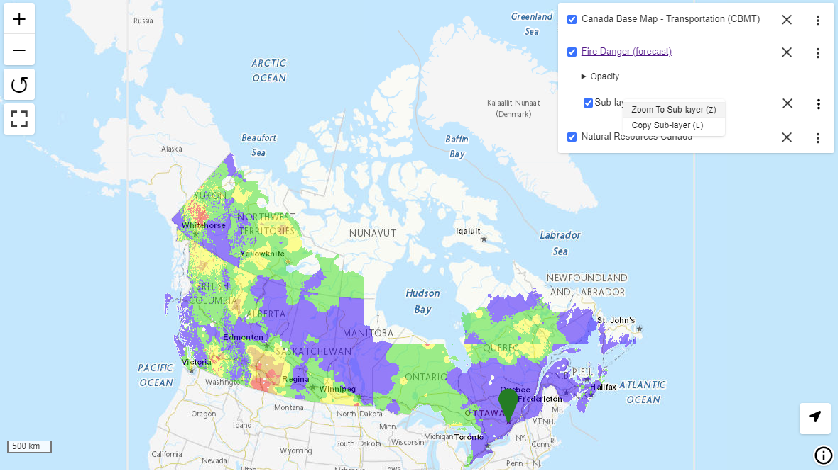
The Viewer
Notes:
Geospatial data can be viewed in a web page as one or more map viewport(s) on the document canvas, or as a single or multi-page Web application, by using the <mapml-viewer> element as many times as required.
Viewer is conceptually like the video or audio element: a set of built-in controls are presented but can be turned off individually or as a group.
Controls are keyboard accessible, navigable with tab / shift-tab.
Controls are not style-able – if you need to style controls, you’ll need to create your own (this is why you can toggle them).
The set of all map features, across all layers, is a single tab stop. Individual features are also interactive and keyboard navigable, via arrow keys / space / enter.
The viewer has a default projection – OSMTILE (“Web Mercator”).

Slide 6
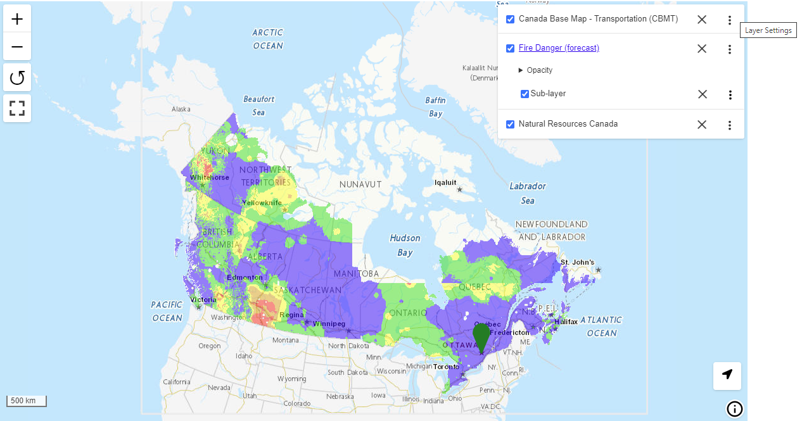
Layers
<mapml-viewer controls controlslist="geolocation" lat="44.960146" lon="-89.993597" projection="CBMTILE" zoom="2">
<layer- checked label="Canada Base Map - Transportation (CBMT)“ src=https://geo.ca/initiatives/canadian-geospatial-data-infrastructure/mapml/></layer->
<layer- checked label=“Fire Danger Forecast”>
<map-extent checked units="CBMTILE">see next slide</map-extent>
</layer->
<layer- checked label=“Natural Resources Canada”>
<map-feature id="NRCan" max="26" min="2" zoom="17">
<map-featurecaption>Natural Resources Canada</map-featurecaption>
<map-properties><h1>NRCan HQ</h1></map-properties>
</map-feature>
</layer->
</mapml-viewer>
Notes:
A map can have zero or more layers of content. For map layers, fewer is more.
Layers are optionally exposed to the user through the layer control, in DOM order: closest to / furthest from document start, parsing in sequence based on distance from document start.
In contrast to the layer control, later-parsed layers render on top of and potentially obscure earlier-parsed layers
Layers contain one ‘level’ of content (metadata, map-feature(s) and/or map-extent(s))
A map-extent is a templated / form construct that fetches remote map content that potentially covers and obscures earlier content (depending on the nature of the content).
Map-extent is exposed in the layer control ‘under’ layers; individual features are not
Layers can also contain feature collections
Layer content is rendered according to the painter’s model, with later-parsed content rendering on top of and potentially obscuring earlier content
For map feature keyboard navigation, layers are ignored / features are treated as though they all come from a single layer

Slide 7

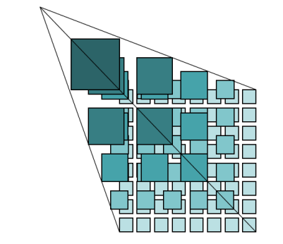
Tiled Coordinate Reference Systems
+
=
TCRS
Tile Matrix Set
EPSG:*
Notes:
Tiles were the original concession of geospatial software to web architecture, enabling as they did, access to identifiable resources informally associated to the Earth.
Tiled Coordinate Reference System concept takes this concession one step further, formally binding an instance of a CRS with an instance of a tile matrix set into a single well-known value of “projection” e.g. OSMTILE.
GeoServer make it possible to access MapML through the WMS / WMTS / WFS interfaces, by defining “MapML” as a CRS “Authority”, which enables obtaining MapML via the GetMap / GetTile / GetFeature interfaces because you can use ‘srsName=MapML:OSMTILE’, for instance. GeoServer manages the association between the TMS and EPSG CRS internally.
There are a few (either well-known or proof-of-concept) TCRS defined by the MapML specification, and there are “Custom TCRS”, which can be defined and used by web developers.

Slide 8
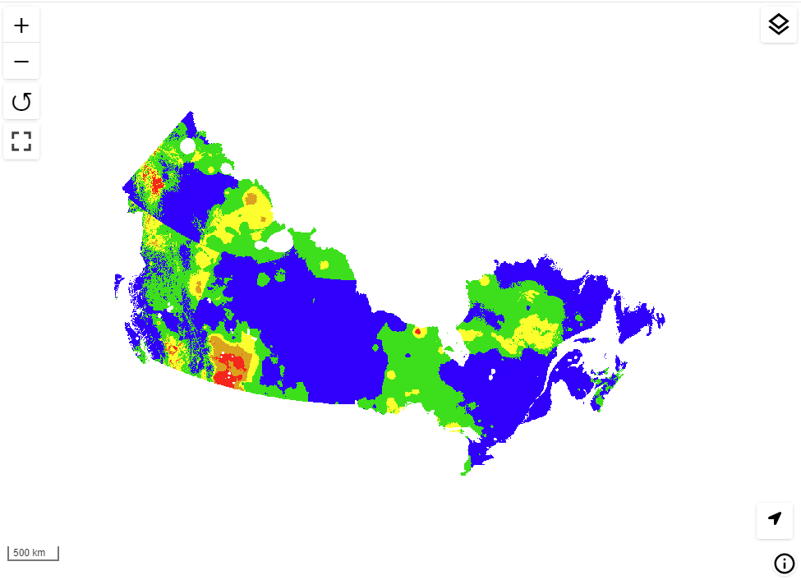
Maps
<map-extent units="CBMTILE" checked hidden>
<map-input name="z" type="zoom" min="0" max="25" ></map-input>
<map-input name="xmin" type="location" rel="map" position="top-left" axis="easting“ units="pcrs" min="-2378164" max="3039835" ></map-input>
<map-input name="ymin" type="location" rel="map" position="bottom-left" axis="northing“ units="pcrs" min="-707617" max="3854382" ></map-input>
<map-input name="xmax" type="location" rel="map" position="top-right" axis="easting“ units="pcrs" min="-2378164" max="3039835" ></map-input>
<map-input name="ymax" type="location" rel="map" position="top-left" axis="northing“ units="pcrs" min="-707617" max="3854382" ></map-input>
<map-input name="w" type="width" min="1" max="4096" ></map-input>
<map-input name="h" type="height" min="1" max="4096" ></map-input>
<map-link rel=“image" tref=/geoserver/nrcan/wms?request=GetMap&crs=MapML:CBMTILE&width={w}&height={h} &bbox={xmin},{ymin},{xmax},{ymax}&layers=fdr_current&format=image/png&styles=&language=en&version=1.3.0&service=WMS&transparent=true”></map-link>
<map-input name="i" type="location" axis="i" units="map" ></map-input>
<map-input name="j" type="location" axis="j" units="map" ></map-input>
<map-link rel="query“ tref="/geoserver/nrcan/wms?request=GetFeatureInfo&info_format=text/mapml&crs=MapML:CBMTILE&bbox={xmin},{ymin},{xmax},{ymax}&language=en&version=1.3.0&transparent=true&service=WMS&query_layers=fdr_current &layers=fdr_current&query_layers=fdr_current&width={w}&height={h}&x={i}&y={j}&feature_count=50&styles="></map-link>
</map-extent>
Notes:
To get the MapML client <mapml-viewer> to make whole-map requests, use the <map-extent> element, with child <map-input> and <map-link> elements structured to describe the whole viewport
The structure can be best understood by examining how a WMS GetMap for an image-based map layer can be templated

Slide 9
Tiles
<map-extent units="CBMTILE" checked hidden>
<map-input name="z" type="zoom" value="25" min="0" max="25" ></map-input>
<map-input name="x" type="location" axis="column" units="tilematrix" min="1906155“ max="2226115" ></map-input>
<map-input name="y" type="location" axis="row" units="tilematrix" min="2093831" max="2363240" ></map-input>
<map-link rel="tile" tref="/geoserver/nrcan/wmts?request=GetTile&tilematrixset=CBMTILE&tilematrix={z}&TileRow={y}&service=WMTS&format=image/png&style=&TileCol={x}&version=1.0.0&layer=nrcan:fdr_current“></map-link>
<map-input name="i" type="location" axis="i" units="tile" ></map-input>
<map-input name="j" type="location" axis="j" units="tile" ></map-input>
<map-link rel="query" tref="/geoserver/nrcan/wmts?request=GetFeatureInfo&format=image/png&i={i}&j={j}&TileCol={x}&version=1.0.0&layer=nrcan:fdr_current&tilematrixset=CBMTILE&tilematrix={z}&TileRow={y}&service=WMTS&infoformat=text/mapml&feature_count=50&style=“></map-link>
</map-extent>
Notes:
Tiles are usually “virtual” in MapML, in the sense that they are usually rendered in their mosaiced location without an explicit <map-tile> element
Tiles are requested of the server using the same templating elements as whole-map requests: the <map-extent>, <map-input> and <map-link> elements.
Tiles can be constructed by WMS GetMap requests with <map-input> and <map-link>s properly arranged, or requested individually via template to cover the viewport
HTML encoding is shown

Slide 10
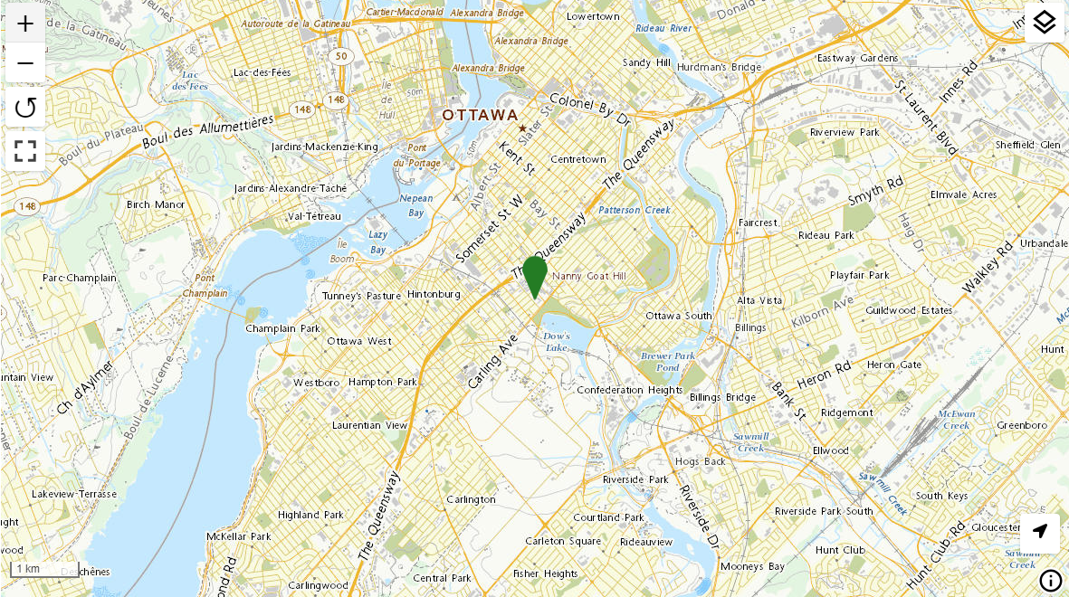
Features
<layer- checked>
<map-meta content="CBMTILE" name="projection"></map-meta>
<map-style> .nrcan { fill: #0F7D21; stroke: #0F7D21; } </map-style>
<map-title>Natural Resources Canada</map-title>
<map-meta name="extent“ content="top-left-easting=1505560, top-left-northing=-169328, bottom-right-easting=1515807, bottom-right-northing=-175352“></map-meta>
<map-feature id="NRCanHQ" max="26" min="2" zoom="17">
<map-featurecaption>Natural Resources Canada Headquarters</map-featurecaption>
<map-properties>
<h2>Natural Resources Canada</h2>
</map-properties>
<map-geometry cs="gcrs">
<map-point class="nrcan">
<map-coordinates>-75.705898 45.399950</map-coordinates>
</map-point>
</map-geometry>
</map-feature>
</layer->
Notes:
Features (and tiles) have their “own” elements in MapML. Such content can be included directly inline in layers (shown) or in remote layers.
Feature requests can be templated like WMS requests, via the <map-link rel=“features” type=“text/mapml” tref=“…”> construct.
In theory, features and tiles can be mixed into a single document. In practice, we still need to evaluate how useful this is. It’s potentially useful in a WMS when requesting vector tiles to be able to intermix raster tiles, if a particular data set can’t be represented as vectors.

Slide 11
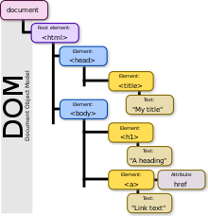

MapML Development: The DOM API
HTML documents are where you begin, with (MapML) elements and attributes
Including an accessible map in HTML should be beginner-level coding
Start with HTML, progress to CSS and eventually to JavaScript programming of the HTML/MapML DOM
The MapML DOM is what developers will work with to customize their maps
Birger Eriksson
Notes:
HTML documents are where you begin, with (MapML) elements and attributes
Including an accessible map in HTML should be “beginner-level” coding (view-source-copy-paste ftw!)
Start with HTML, progress to CSS and eventually to JavaScript programming of the HTML/MapML DOM
The MapML DOM is what developers will work with to customize their maps

Slide 12
The HTML<MapML>Element API
Properties
Can be used to access and in some cases control state
Bounding boxes are represented by the .extent property.
Other properties include controls, controlsList, extent, projection, width, height, zoom, min, max, checked, hidden, disabled, label, src, opacity. Often ‘initializable’ by an attribute of the same name.
Methods
Things that have .extent property also expose the .zoomTo() method
Can pan/zoom map arbitrarily via <mapml-viewer>.zoomTo(lat,lon,zoom)
GeoJSON support!
<mapml-viewer>.geojson2mapml(j, options) – adds and returns a <layer->
<layer->.mapml2geojson(options) – returns GeoJSON FeatureCollection object
<map-feature>.mapml2geojson(options) – returns a GeoJSON Feature object
Events
A wide variety of useful events are emitted across the MapML vocabulary
Check the docs under Events for each element API.

Slide 13
MapML Software Resources
Web browsers – Web-Map-Custom-Element
Install via npm – npm install @maps4html/web-map-custom-element
API documentation – https://maps4html.org/web-map-doc/docs/
MapML examples - https://maps4html.org/experiments/
MapML portal on geo.ca - https://geo.ca/initiatives/canadian-geospatial-data-infrastructure/mapml/
GeoServer – WMS, WMTS, WFS, HTML preview https://docs.geoserver.org/latest/en/user/extensions/mapml/index.html

Slide 14

Thank You
Community

